Slide 1
CARDIOVASCULAR Healthcare Segmentation: Predictive Analysis Using Machine Learning
CAPSTONE PROJECT
Presented By:
T. P. Rajarajan
112721214013
St. Peter's College of Engineering and Technology
Department of Biotechnology

Slide 2
OUTLINE
Problem Statement
Proposed System/Solution
System Development Approach
Algorithm & Deployment
Result
Conclusion
Future Scope
References

Slide 3
Problem Statement
Cardiovascular disease (CVD) is a leading cause of mortality worldwide, contributing to a significant burden on healthcare systems and society. Early identification of individuals at high risk of developing CVD is crucial for implementing preventive interventions and reducing morbidity and mortality associated with the disease.

Slide 4
Proposed Solution
The objective of this project is to develop a predictive model that can estimate the risk of developing cardiovascular disease for each patient based on their current health conditions and habits.
The project follows a structured approach, encompassing data collection, preprocessing, modeling, evaluation, and deployment stages.
The developed predictive model will enable healthcare professionals to accurately estimate the risk percentage of developing cardiovascular disease for individual patients.
This will facilitate early identification of high-risk individuals and the implementation of targeted preventive interventions, ultimately leading to improved patient outcomes and reduced healthcare costs associated with CVD.

Slide 5
SPECIFICATIONS/REQUIREMENTS
Hardware Specifications:
CPU: Intel Core i5 or higher (recommended)
RAM: 8GB or more
Storage: At least 100GB of free disk space
Software Requirements:
Operating System: Windows 10, macOS, or Linux
Python 3.x installed
Jupyter Notebook or any Python IDE (Integrated Development Environment) for running the code
Required Python libraries: pandas, numpy, matplotlib, seaborn, scikit-learn
Optional:
GPU (Graphics Processing Unit) support for faster model training (NVIDIA GPU with CUDA support)
Virtual environment for managing Python dependencies, such as Anaconda or virtualenv

Slide 6
System Approach
Data Preprocessing:
Handle missing values: Impute missing values using appropriate techniques such as mean, median, or mode imputation.
Encode categorical variables: Convert categorical variables into numerical format using techniques like one-hot encoding or label encoding.
Scale numerical variables: Scale numerical variables to ensure they have the same scale, which can improve model performance.
Exploratory Data Analysis (EDA) Subsystem:
Conducts exploratory data analysis to gain insights into the distribution of risk factors and their relationships with CVD risk.
Utilizes visualization techniques to identify patterns, correlations, and outliers in the data.
Guides feature engineering and selection processes by highlighting relevant variables for modeling.

Slide 7
System Approach
Feature Engineering Subsystem:
Creates new features or transforms existing ones to capture additional information relevant to CVD risk prediction.
Implements techniques such as binning, interaction terms, and polynomial features to enhance model performance.
Collaborates with domain experts to incorporate domain knowledge into feature engineering strategies.
Model Selection and Training:
Choose appropriate machine learning algorithms for regression tasks, such as linear regression, decision trees, random forests, or gradient boosting.
Train the selected models on the dataset and evaluate their performance using appropriate evaluation metrics.

Slide 8
System Approach
Model Evaluation and Interpretation:
Assess the performance of the trained models using cross-validation techniques and identify the best-performing model.
Interpret the trained model to understand the impact of different risk factors on CVD risk and provide actionable insights for risk assessment and prevention.
Deployment and Integration:
Deploy the trained model into a production environment where it can be used to predict CVD risk for new patients.
Develop a user-friendly interface for healthcare professionals to input patient information and receive risk predictions in real-time.
Constraints and Considerations:
Privacy and security of patient data must be ensured throughout the system.
The system should be scalable and adaptable to accommodate changes in data sources and modeling techniques.
Regular monitoring and updates are necessary to maintain model accuracy and relevance over time.

Slide 9
Algorithm & Deployment
Algorithm Selection
Logistic Regression:
Well-suited for binary classification tasks like predicting cardiovascular disease risk and relationship between risk factors and disease risk.
Fast training and inference times, making it efficient for large datasets.
Random Forest:
Ensemble learning algorithm that combines multiple decision trees to improve prediction accuracy.
Handles non-linear relationships and interactions between risk factors effectively.
Gradient Boosting Machines (GBM):
Builds a sequence of weak learners (typically decision trees) to minimize prediction errors.
Provides high predictive accuracy and is robust to overfitting when tuned properly.
Handles complex relationships and interactions between risk factors effectively.

Slide 10
Algorithm & Deployment
Deployment
Model Deployment:
Deploy the selected model (e.g., logistic regression, random forest, or GBM) into a production environment using a web application framework such as Flask or Django.
Serialize the trained model using libraries like joblib or pickle to save it as a file.
Develop APIs to expose model endpoints for receiving patient data and returning CVD risk predictions.
Ensure the deployed model integrates seamlessly with existing healthcare systems and workflows.
User Interface Development:
Develop a user-friendly interface for healthcare professionals to input patient information.
Use web development technologies like HTML, CSS, and JavaScript to create an interactive interface.
Integrate the user interface with the backend model deployment framework to enable real-time risk predictions.

Slide 11
Algorithm & Deployment
Testing and Validation:
Perform thorough testing of the deployed model and user interface to ensure functionality and usability.
Validate model predictions against known outcomes and evaluate performance metrics such as accuracy, precision, recall, and AUC-ROC.
Incorporate feedback from healthcare professionals to refine the user interface and improve the model's predictive performance.
Monitoring and Maintenance:
Set up monitoring tools to track the performance of the deployed model and user interface in real-time.
Monitor data quality, model drift, and user engagement to identify potential issues and opportunities for improvement.
Establish a maintenance schedule to update the model periodically with new data and retrain as necessary to ensure its accuracy and relevance over time.

Slide 12
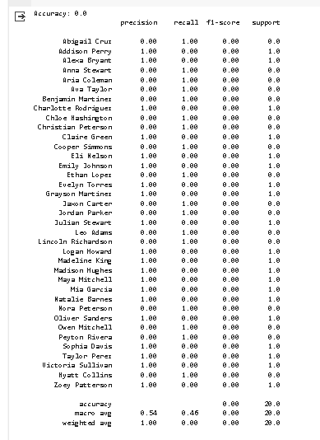
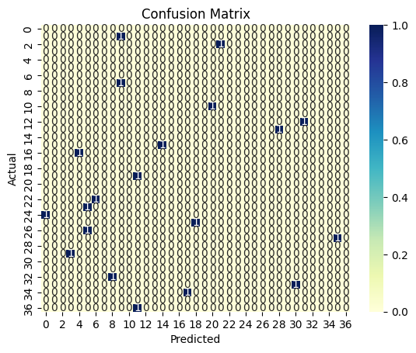
Result
Accuracy: The accuracy of the trained model on the test data is reported.​
Classification Report: It provides precision, recall, F1-score, and support for each class in the target variable.​
Confusion Matrix: A heatmap representation of the confusion matrix is displayed, showing the true and predicted labels.

Slide 13
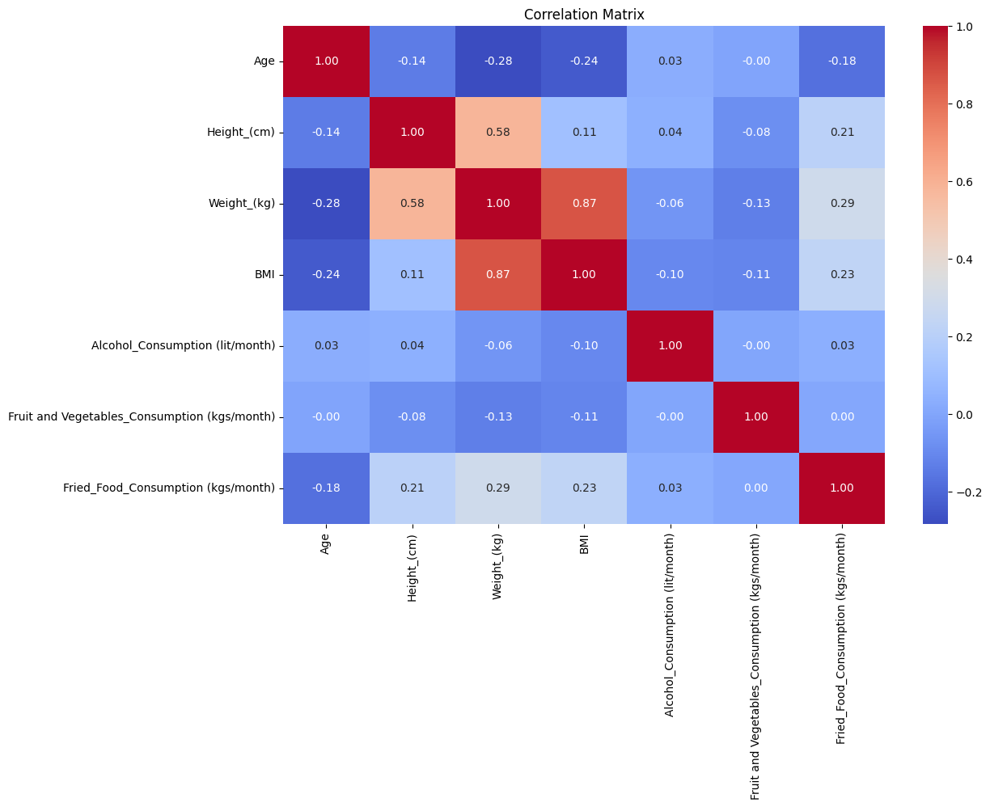
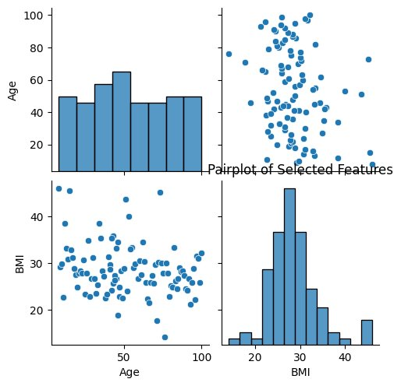
Result
Distribution of Target Variable: A count plot showing the distribution of the target variable (patient names).
Correlation Matrix: A heatmap of the correlation matrix of all numerical features in the dataset.

Slide 14
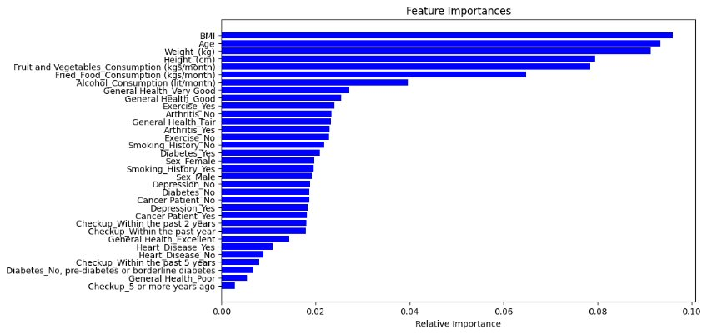
Result
Feature Importance Plot: A horizontal bar plot showing the relative importance of each feature in predicting the target variable.
Pairplot of Selected Features: If selected features exist in the dataset, a pairplot of those features is displayed for visualization.

Slide 15
Conclusion
The project aimed to build a predictive model for patient classification based on various features including demographics, clinical biomarkers, and medical history.
Data preprocessing involved handling missing values, scaling numeric features, and encoding categorical variables.
A RandomForestClassifier was trained using a pipeline that included preprocessing steps and the classifier itself.
Model evaluation metrics such as accuracy, precision, recall, and F1-score were computed to assess the model's performance.
Feature importance was visualized to understand which features contributed most to the model's predictions.
Additional visualizations including the distribution of the target variable and correlation matrix were provided for better insights into the dataset.
This model can assist healthcare professionals in identifying high-risk patients and implementing preventive measures to reduce the incidence of cardiovascular disease.

Slide 16
Future scope
Integration with Wearable Devices:
Incorporate data from wearable devices such as fitness trackers, smartwatches, and continuous glucose monitors to gather real-time physiological data.
Develop algorithms to analyze streaming data from wearable devices and provide personalized risk assessments based on recent health metrics.
Continuous Model Improvement:
Continuously refine and update the predictive model based on new research findings, emerging risk factors, and advances in machine learning techniques.
Global Collaboration and Knowledge Sharing:
Establish data sharing initiatives and open-access repositories to facilitate reproducibility and transparency in cardiovascular research and model development.
Advanced Machine Learning Techniques:
Explore advanced machine learning techniques such as deep learning, recurrent neural networks (RNNs), and convolutional neural networks (CNNs) to capture complex patterns and temporal dependencies in patient data.

Slide 17
Future scope
Integration with Electronic Health Records (EHRs):
Integrate the predictive model with electronic health record systems to provide seamless risk assessments during routine clinical encounters.
Enhance interoperability and data sharing capabilities to enable healthcare providers to access patient risk predictions across different healthcare settings.
Population Health Management:
Scale the predictive model to population-level analyses to identify trends and patterns in cardiovascular disease risk across different demographic groups and geographic regions.
Inform public health interventions and policy decisions aimed at reducing population-level cardiovascular disease burden and disparities.
Genomic Risk Prediction:
Incorporate genetic information and polygenic risk scores into the predictive model to assess individuals' genetic predisposition to cardiovascular disease.
Explore the use of genomic data to personalize treatment strategies and optimize therapeutic outcomes for high-risk patients.

Slide 18
References
National Center for Health Statistics. Health, United States, 2017. Table 19: Leading Causes of Death and Numbers of Deaths, by Sex, Race, and Hispanic Origin: United States, 1980 and 2016 [PDF-776M]. Hyattsville, MD: National Center for Health Statistics; 2018. Accessed May 9, 2019.
https://asthamariskprediction.onrender.com/
https://archive.ics.uci.edu/ml/datasets/Heart+Disease
-https://www.kaggle.com/c/santander-customer-satisfaction
vigneshmuthuvelan/DataScienceProject (github.com)

Slide 19
THANK YOU

